Slide 1

Customer Relationship Management (CRM)- System With AI based Live Chat System

Slide 2
Introduction
SRS Overview:
This document outlines all the functional and non-functional requirements of the CRM system in detail.
Purpose of the SRS:
To serve as a blueprint for system development, testing, and future maintenance.

Slide 3
Project Objective & Scope
Objective:
To build a lightweight and efficient CRM system that allows easy
management of customer information.
Scope:
Single admin panel for full control
Local web-based system using json-server
Core CRUD operations for clients (Create, Read, Update, Delete)

Slide 4
Technologies Used
Frontend: React.js with Next.js for building the interface
State Management: Redux for predictable data handling
API Communication: Axios for handling HTTP requests
Form Management: Formik with Yup for validation
User Interaction: SweetAlert2 for enhanced user alerts
Mock Backend: json-server to simulate backend data

Slide 5
System Features Overview
Secure login for admin users
Client listing with sorting and filtering capabilities
Form to add new client entries
Edit functionality to update client details
Delete function with confirmation alerts
Clean and responsive user interface

Slide 6
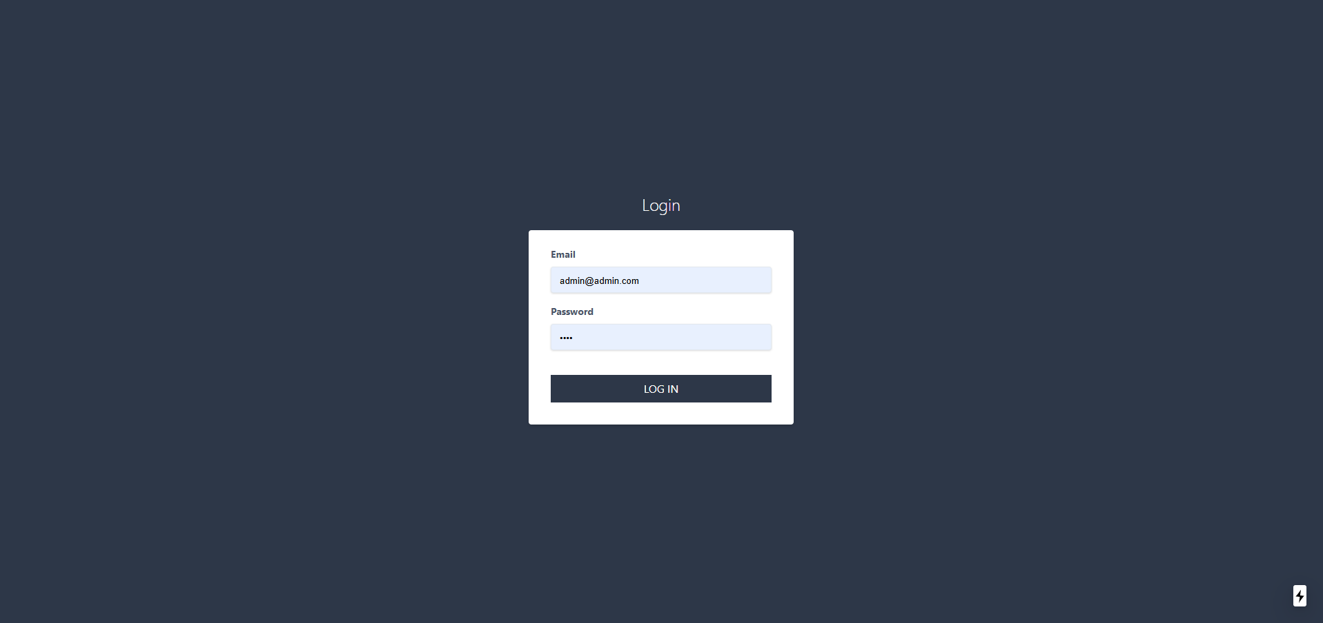
Login Panel

Slide 7
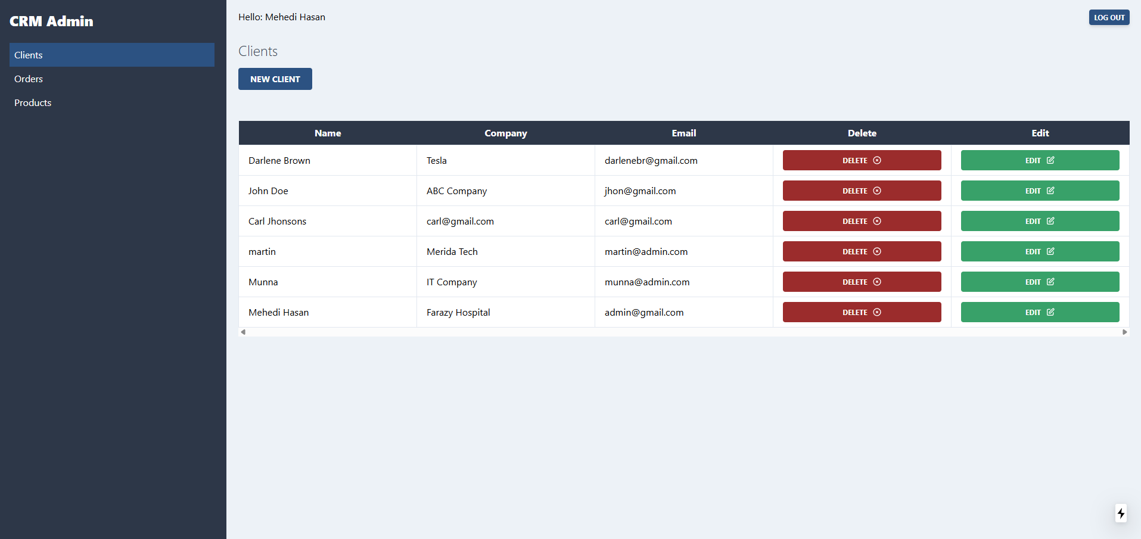
Admin Dashboard

Slide 8
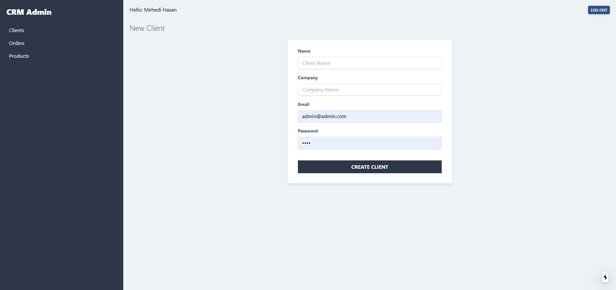
New Client Adding Panel

Slide 9
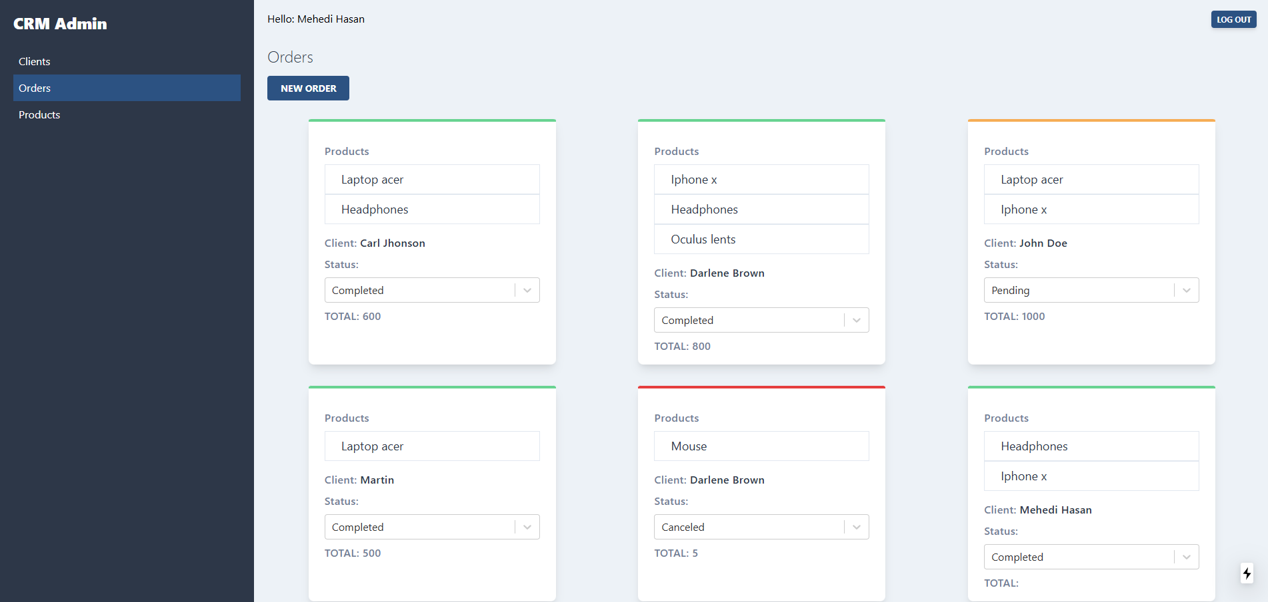
Order Dashboard

Slide 10
Functional Requirements
FR1: Login system for admin authentication
FR2: View all clients in a tabular format
FR3: Add client data (name, email, contact info)
FR4: Edit existing client entries
FR5: Delete clients with confirmation
FR6: Real-time search and filtering

Slide 11
Non-Functional Requirements
Responsiveness: Adaptable layout across all devices
Validation: Robust input validation on all forms
Notifications: Informative and stylish pop-ups using SweetAlert2
Performance: Smooth navigation and quick response times

Slide 12
Interface Design
Login Page:
Simple and intuitive login form for admin access
Dashboard:
Table layout with client details, including sort and filter
Client Form:
User-friendly interface for adding and editing clients with validation

Slide 13
External Components Used
Axios: Manages HTTP methods (GET, POST, PUT, DELETE)
json-server: Serves as a mock REST API for development
Formik & Yup: Efficiently handle form state and validation logic
SweetAlert2: Provides visually appealing alert modals

Slide 14
Conclusion
Developed a functional and academic-level CRM system
Included all required features for client management
Seamless integration between frontend and backend
Focused on usability, reliability, and simplicity

Slide 15




Thank You
Mehedi Hasan
Tonny Talukder
Fahim Shahariar Alvi
Taposhi Rabeya Fardin

